Slide 1

Concordia ENGWEEK2021 Junior Design Challenge
Presentation By: Ribelle El Ayoub
Jaskirat Kaur
Simren Matharoo
Nazmus Sakib

Slide 2
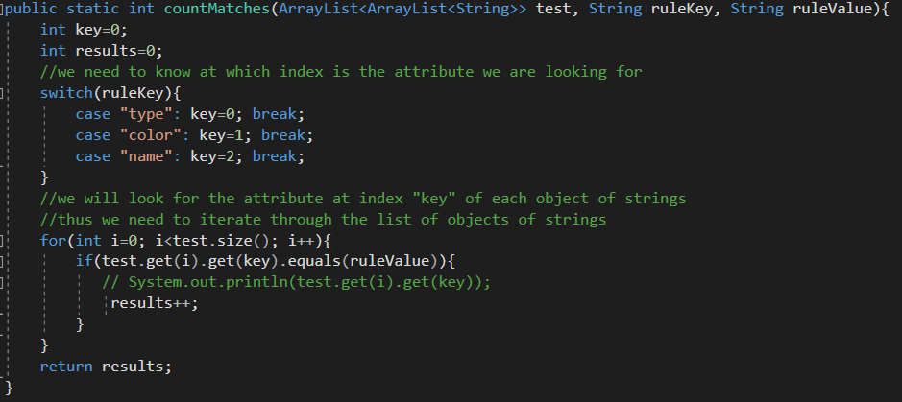
1. Programming
Part A : Count Items Matching Rules

Slide 3
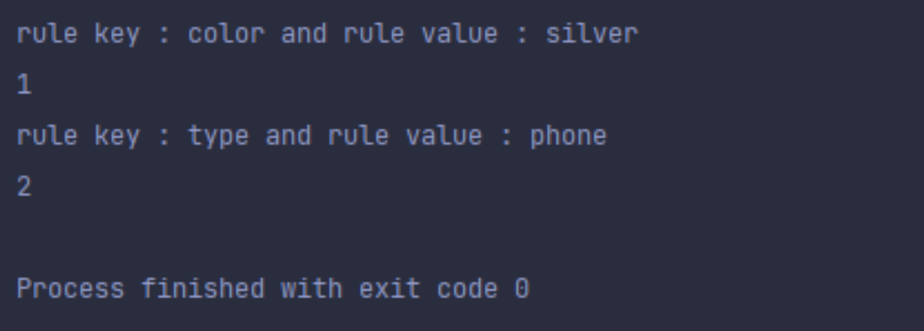
Programming
Part A Results

Slide 4
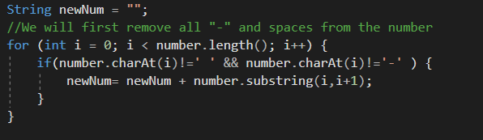
Programming
Part B : Reformat Number

Slide 5
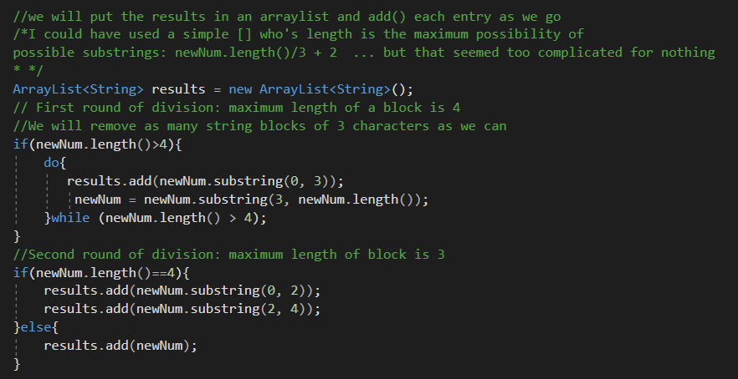
Programming
Part B : Reformat Number

Slide 6
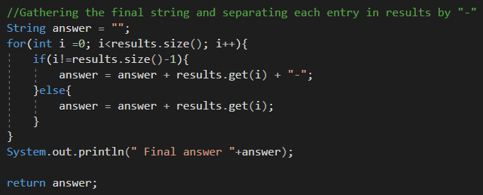
Programming
Part B : Reformat Number

Slide 7
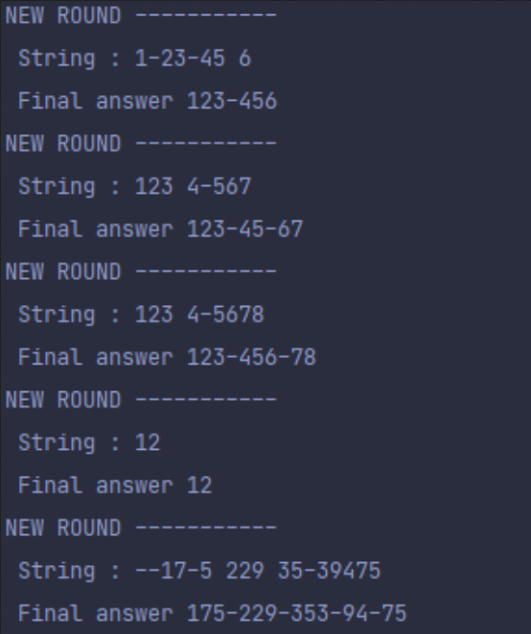
Programming
Part B : Results

Slide 8
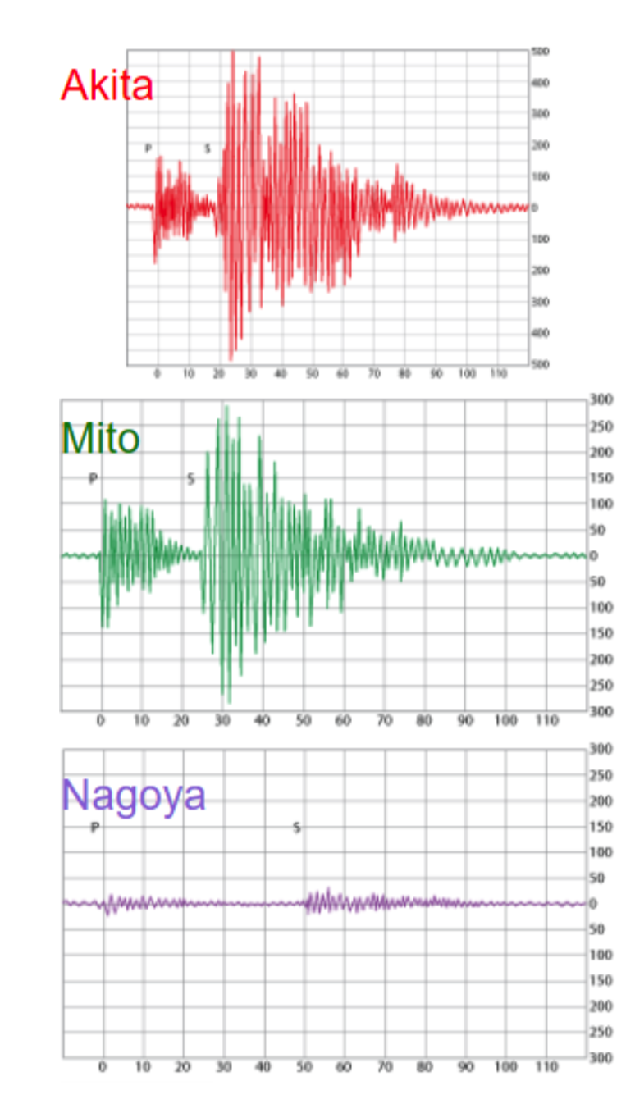
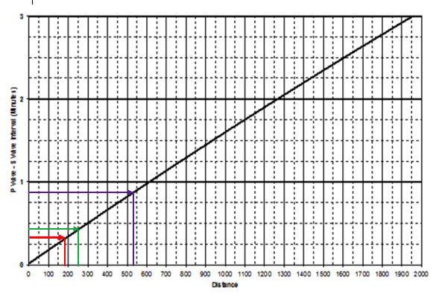
2. Earthquake Dilemma

Slide 9
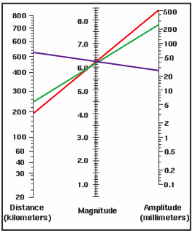
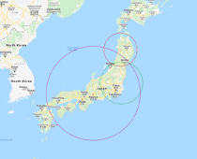
6.2 magnitude in the Richter scale
Epicenter: Oshika Peninsula, Ishinomaki, Japan.

Slide 10
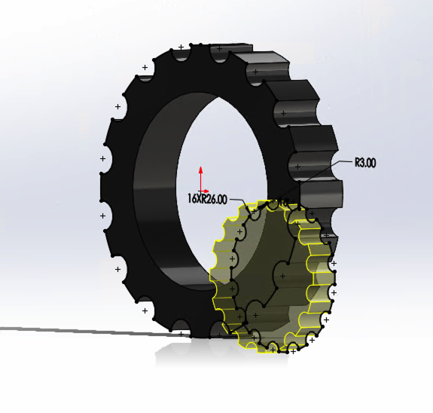
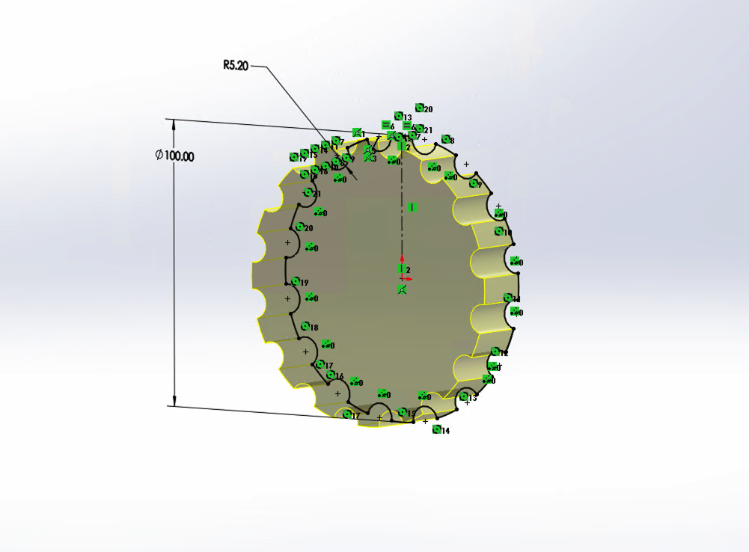
3. 3D Logo Design

Slide 11
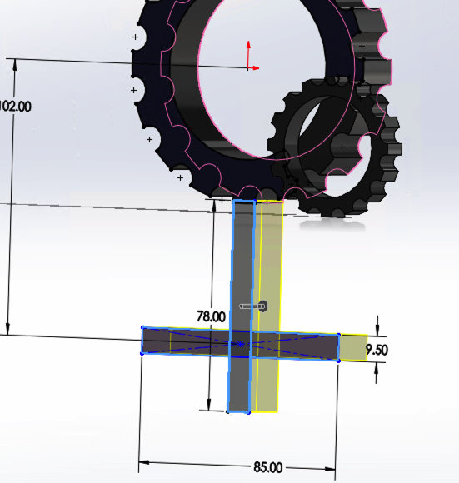
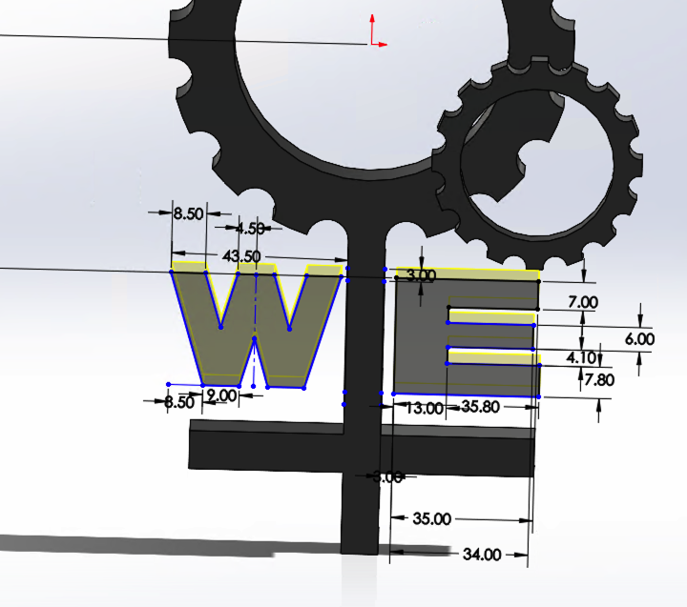

Slide 12
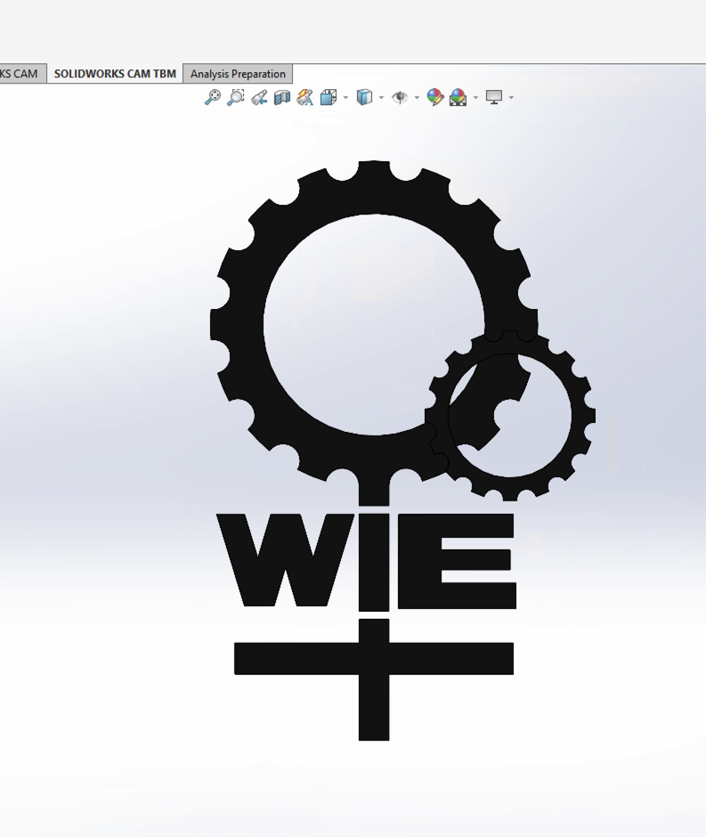
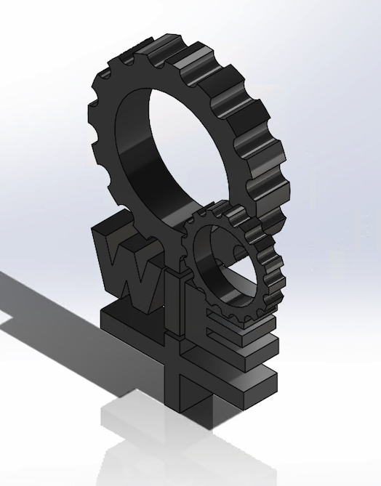

Slide 13
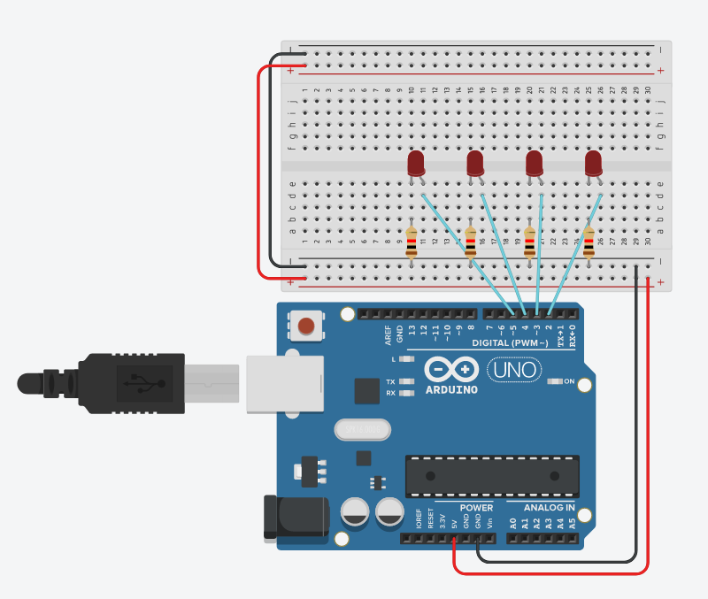
4. Circuit Design
Part A : LED Binary Counter

Slide 14
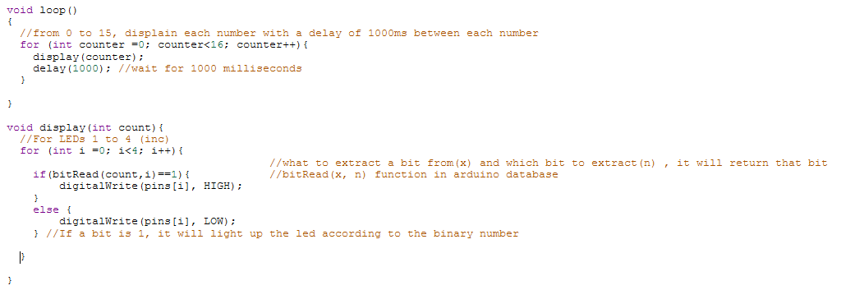
4. Circuit Design
Part A : LED Binary Counter

Slide 15
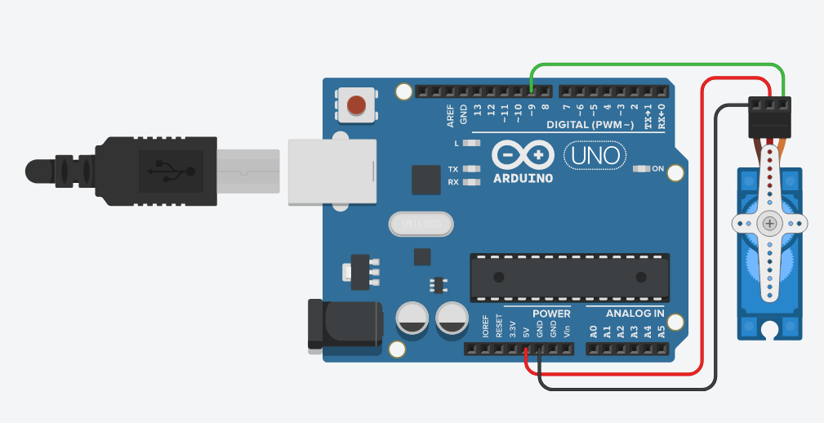
4. Circuit Design
Part B : Simple Spinning Servo

Slide 16
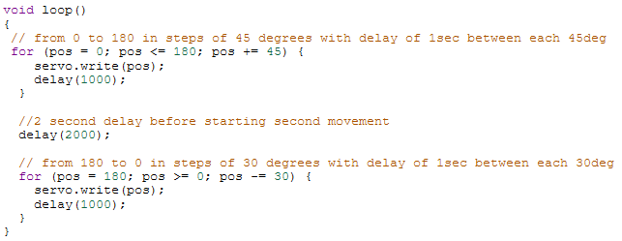
4. Circuit Design
Part B : Simple Spinning Servo

Slide 17
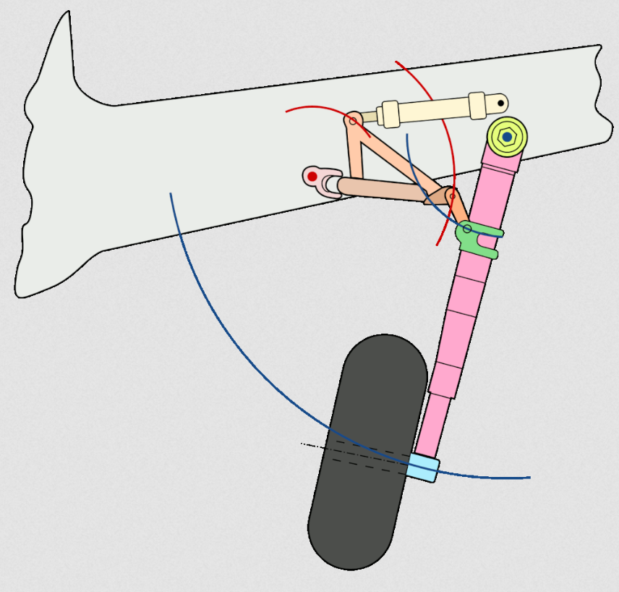
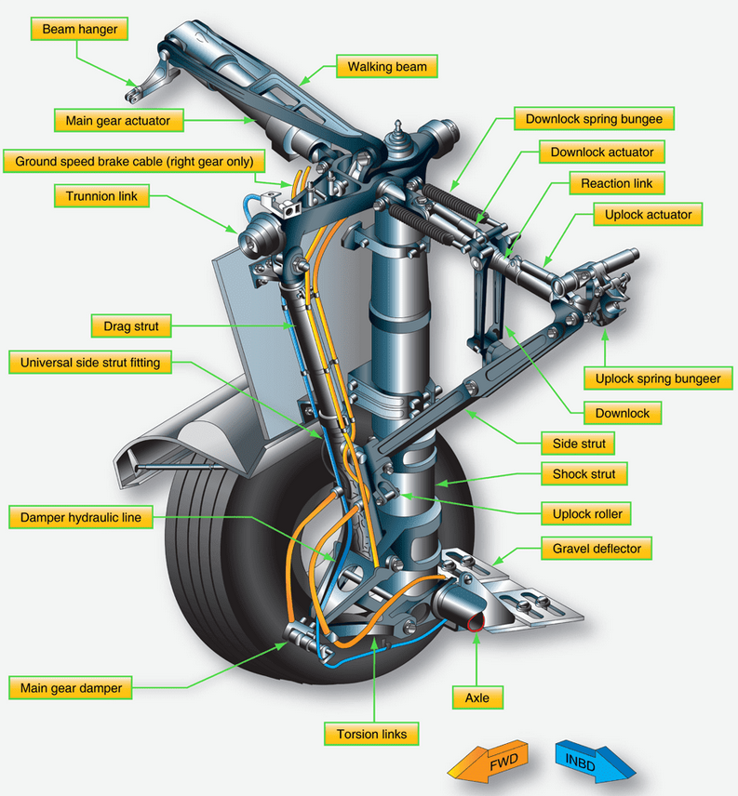
5. Aero Mechanism Description
https://www.century-of-flight.net/wp-content/uploads/2020/12/how-retractable-landing-gear-works.gif
https://www.century-of-flight.net/wp-content/uploads/2020/12/how-retractable-landing-gear-works.gif

Slide 18
5. Aero Mechanism Description
Part 1: Main Gear
It is electrically controlled and hydraulically operated.They are mounted under the wing and retract sideways. Hydraulic actuators are responsible for the retraction.
Part 2: Torque Link Damper
It prevents the inner cylinder from rotating in the outer cylinder and also prevents the wheels from shimmes.
Part 3: Shock Absorber
It reduces the impact of the lockdown while landing.

Slide 19
End

